Slide 1


Auto Insurance claim Fraud Detection Using Data Science and ML
Team – Bird Eye
Anup Kumar Mishra

Slide 2
Introduction to Auto Insurance fraud
Common Types of Fraud:
1. Ditching: A fraudster finances an expensive vehicle with a minimal down payment, strips the expensive parts for resale, and reports the auto as stolen to the police and insurance company.
2. Past posting: A person who doesn't have insurance coverage is involved in an automobile accident, purchases insurance after the fact and waits several days before reporting the accident to the insurance company.
3. Vehicle repair: During the car repair phase, fraudsters replace needed parts in vehicles with refurbished parts. However, the claims they submit to insurance providers reflect pricing for new, premium parts.
4. Vehicle smuggling: Smugglers purchase expensive vehicles with maximum financing, prepare counterfeit certificates to prove the vehicles are free from debt, ship the automobiles to foreign destinations for sale and report the cars as stolen to insurance providers.
5. Phantom vehicles: A fraudster provides a counterfeit automobile certificate of title to the insurance agent when he's buying insurance coverage although no real vehicle exists. The fraudster then reports the car as stolen to the police and the insurance company.
6. 30-day special: A fraudster reports a vehicle as stolen, hides the vehicle for a short period (usually for 30 to 45 days) to get a settlement for the claim, then abandons, destroys or sells the car to a "chop shop" after receiving the insurance claim proceeds.
7. Paper accident: These accidents only exist on paper. An insurance company might not investigate in detail when the repair costs fall below a certain threshold. Because this is a low-risk endeavor and the authorities aren't involved, this is a popular organized crime ring scheme.

Slide 3

Manual Claims Processing & Red Flags
The time between a claim and purchase of a policy is short — several weeks or a couple of months.
An insured driver has had several claims in the past
Excessive amount of insurance coverage.
An insured driver shows great knowledge about insurance coverage and claim procedures, and pushes the insurer for a fast settlement of a claim.
A claimed damaged vehicle has been discarded before examination by an insurance company claims adjuster.
The submission of an altered police report by a claimant. (Insurance claims departments should obtain reports directly from law enforcement.)
Unexplained significantly larger physical damage to an insured car compared to the amount of damage to an uninsured car.
Inconsistencies among the physical evidence, the loss outlined in the police report and the invoice submitted by the repair shop.

Slide 4
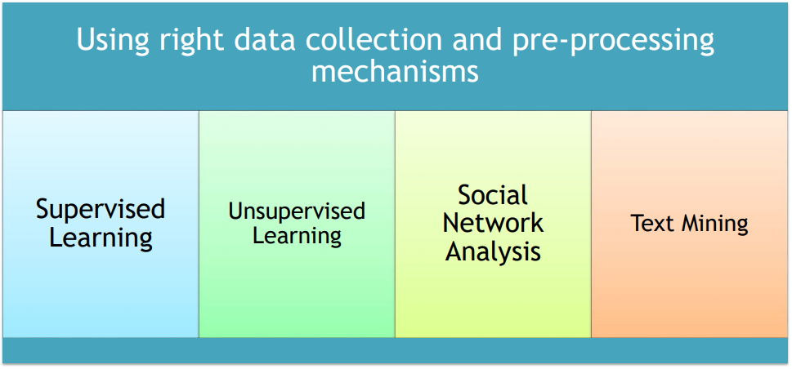
Machine Learning Approaches
Overview of Different Methods
Note: We are focusing on supervise learning

Slide 5
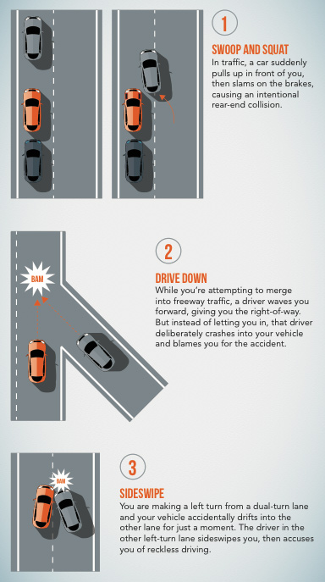
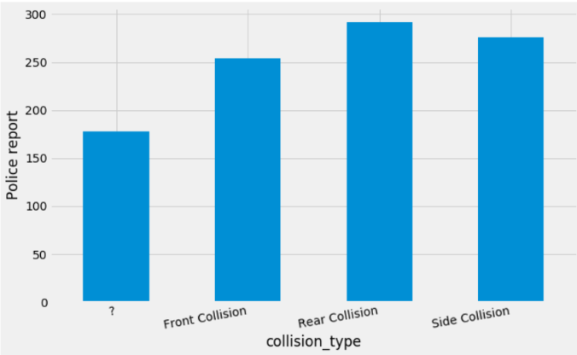
Common Staged Accidents
1. The Front Collision
2. The Side swipe / Collision
3. The Drive Down/ Front Collision
4. Unknown

Slide 6
Machine Learning Approaches
Supervised Learning
Outcome variable (Fraud Indicator) is linked to explanatory variables
Feature selection, Feature engineering to identify best predictors
Relationships between the variables assessed • Stand alone Models
Label Encoder
Linear Discriminant Analysis
Random Forest Classifier
Logistic Regression
K Neighbors Classifier
Weaknesses
Demand a labeled (initial) data set
Only suitable for larger, richer data sets

Slide 7
Machine Learning Approaches
Supervised Learning – Ensemble Learning
New machine-learning framework - Treats multiple learners as different modules to solve the same problem
Improves the generalization ability of learning systems significantly
Randomized Search
Bagging
Random Decision Forests → Combines Bagging and Random subspace methods
Automatically selects features - Not sensitive to irrelevant features
Reduces possibility of overfitting
Considers the interaction between features
Applicable to binary class and multiple class problems
Does not require complex parameter selection process
Performance of RF depends on the classification ability of each tree and the diversity and correlation among them

Slide 8
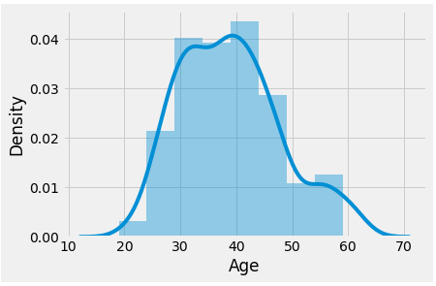
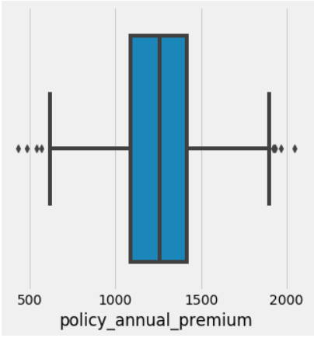
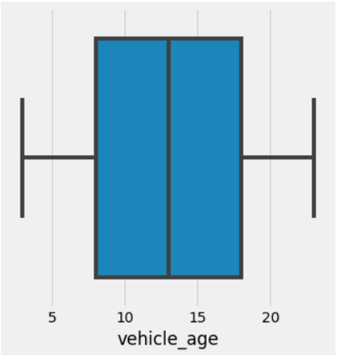
Machine Learning Approaches

Slide 9
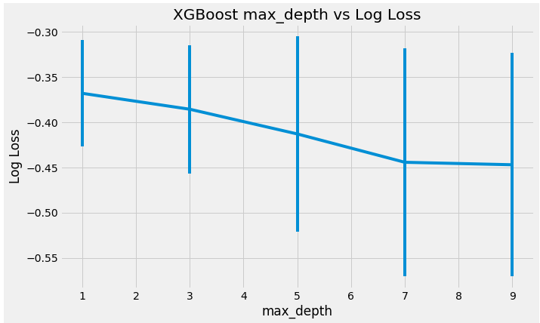
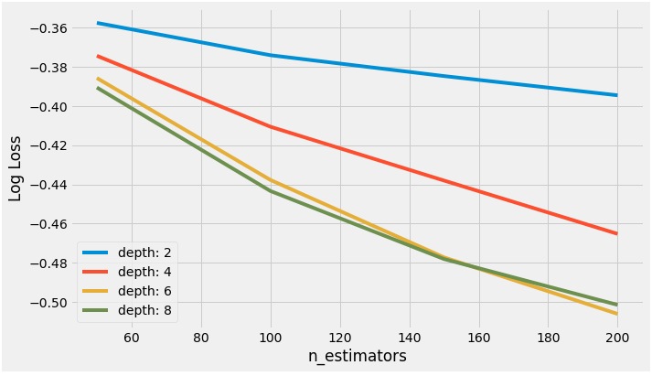

Slide 10

Thank You

